Slide 1
SQL Lesson 9a
Single-Row Functions Part 2
V1.0 2020

Slide 2
Lesson Objectives
After completing this lesson you will
Know when to use datatype conversion functions
Be able to nest functions as needed
Understand how to use functions that work with nulls
Know how to apply conditional expressions using CASE expression and DECODE function in a query

Slide 3
Single-row functions
Previous lesson | This lesson
Character data functions | Datatype conversion functions
Number data functions | Nulls function
Date data functions

Slide 4
Single-Row Functions Part 2
1. Subject (Arial 20)
Datatype Conversion Functions
Nesting Functions
Nulls Functions
Conditional Expressions

Slide 5
Datatype Conversion Functions
Use TO_CHAR function to convert dates and/or numbers into characters
Date formats can be changed from the default DD-MON-RR format into a more readable set of characters
Numbers can also be formatted into more readable characters
Character strings can be converted into dates using TO_DATE function

Slide 6
TO_CHAR function with dates
TO_CHAR(date, ‘format model’)
Converts dates from the default DD-MON-RR format to a more readable format based on the format model you provide
The format model:
- Must be enclosed in single quotes
- May be caSe sEnsiTive
- Use fm to remove extra spaces and/or leading zeros

Slide 7
TO_CHAR function with dates
Elements of the Date Format Model
Element | Decription
YYYY | Four digit year
YEAR | Year spelled out – case sensitive
MONTH | Month spelled out – case sensitive
MON | Three letter month – case sensitive
MM | Two digit month
DAY | Day of the week spelled out – case sensitive
DY | Three letter day – case sensitive
DD | Two digit day of the month

Slide 8
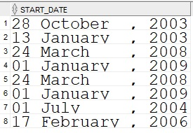
TO_CHAR function with dates
SELECT TO_CHAR(start_date, ‘DD Month, yyyy’) AS start_date
FROM job_history;

Slide 9
TO_CHAR function with dates
More Elements of the Date Format Model
Element | Decription
AM or PM | Meridian Indicator
A.M. or P.M. | Meridian Indicator with periods
HH or HH12 or HH24 | Hour of day 12-11 or 12-11 or 00-23
MI | Minutes 0-59
SS | Seconds 0-59
SSSSS | Seconds since midnight 00000-86399

Slide 10

TO_CHAR function with dates
SELECT TO_CHAR(sysdate, 'DD Month, yyyy HH:MI:SS AM') AS right_now
FROM dual;

Slide 11
TO_CHAR function with numbers
TO_CHAR(number, 'format model')
Elements of the Number Format Model
Element | Decription
9 | Represents one digit
0 | Forces a zero to be displayed
$ | Displays a floating dollar sign
. | Displays a decimal point
, | Displays a comma
L | Floating local currency symbol
G | Local group separator
D | Local decimal symbol

Slide 12

TO_CHAR function with numbers
SELECT TO_CHAR(salary, '$999,999.99') AS salary
FROM employees
WHERE department_id = 20;

Slide 13

TO_DATE function
Converts characters into dates using the same available format elements as TO_CHAR
SELECT last_name, salary, hire_date
FROM employees
WHERE hire_date >= TO_DATE('December 1, 2009','Month dd, yyyy');

Slide 14
Single-row functions part 2
Datatype Conversion Functions
1. Subject (Arial 20)
Nesting Functions
Nulls Functions
Conditional Expressions

Slide 15
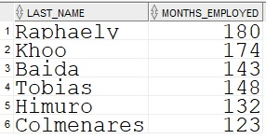
Nesting functions
Example 1
Functions can be placed inside other functions as needed
SELECT last_name, ROUND(MONTHS_BETWEEN(SYSDATE, hire_date),0)
AS months_employed
FROM employees
WHERE department_id = 30;

Slide 16
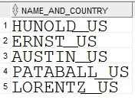
Nesting functions
Example 2
SELECT UPPER(CONCAT(SUBSTR(last_name,1,8),'_US')) AS name_and_country
FROM employees
WHERE department_id = 60;

Slide 17
Single-Row Functions Part 2
Datatype Conversion Functions
1. Subject (Arial 20)
Nesting Functions
Nulls Functions
Conditional Expressions

Slide 18
NULLS functions
The following functions work with nulls
Function | Decription
NVL(val1, val2) | If val1 is null, returns val2
NVL2(val1, val2, val3) | If val1 is NOT null, returns val2, else returns val3

Slide 19
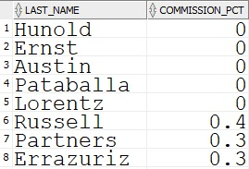
NVL function
Converts a null to a substitution value
NVL(column, substitution value)
SELECT last_name, NVL(commission_pct, 0) AS commission_pct
FROM employees
WHERE department_id IN(60, 80);

Slide 20
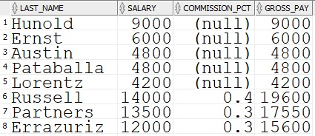
NVL2 function
NVL2 examines the first value. If it is NOT NULL, the second value is returned. If the first value is NULL, the third value is returned.
NVL2(column, substitution_value1, substitution_value_2)
SELECT last_name, salary, commission_pct, NVL2(commission_pct, salary+salary*commission_pct, salary)
AS gross_pay
FROM employees;

Slide 21
Single-Row Functions Part 2
Datatype Conversion Functions
1. Subject (Arial 20)
Nesting Functions
Nulls Functions
Conditional Expressions

Slide 22
Conditional Expressions
Provide IF-THEN-ELSE logic within a SQL statement
Two methods:
- CASE expression – ANSI SQL, follows the ISO standards
- DECODE function – ORACLE extension

Slide 23
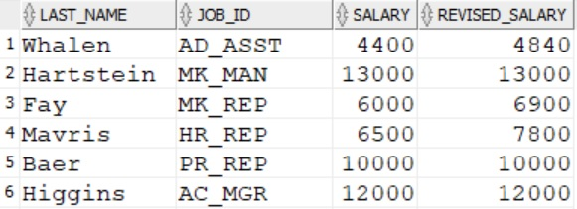
CASE expression
SELECT last_name, job_id, salary,
CASE job_id WHEN 'AD_ASST' THEN 1.1 * salary
WHEN 'MK_REP' THEN 1.15 * salary
WHEN 'HR_REP' THEN 1.2 * salary
ELSE salary END AS revised_salary
FROM employees;

Slide 24
DECODE function
SELECT last_name, job_id,
DECODE (job_id, 'AD_ASST' , 1.1 * salary,
'MK_REP' , 1.15 * salary,
'HR_REP' , 1.2 * salary,
salary) AS revised_salary
FROM employees;

Slide 25
Quiz
True or false?
The TO_CHAR function converts numbers as well as dates into characters for formatting purposes
Many format elements used with TO_CHAR or TO_DATE are case sensitive
Single-row functions can be nested inside one another
Functions that deal with NULLs will take action when they encounter a space or a zero
CASE expression and DECODE function provide IF, THEN, ELSE logic

Slide 26
Review
In this lesson you learned how to
Differentiate between single-row functions and group functions
Aggregate data with Group Functions
Break out aggregated data into separate groups
Include or exclude groups by using the having clause
Nest group-functions inside one another

Slide 27
Questions?

